Slide 1
Taj Mahal (ताजमहल)
Savenkov Denis and Zueva Valeriya

Slide 2
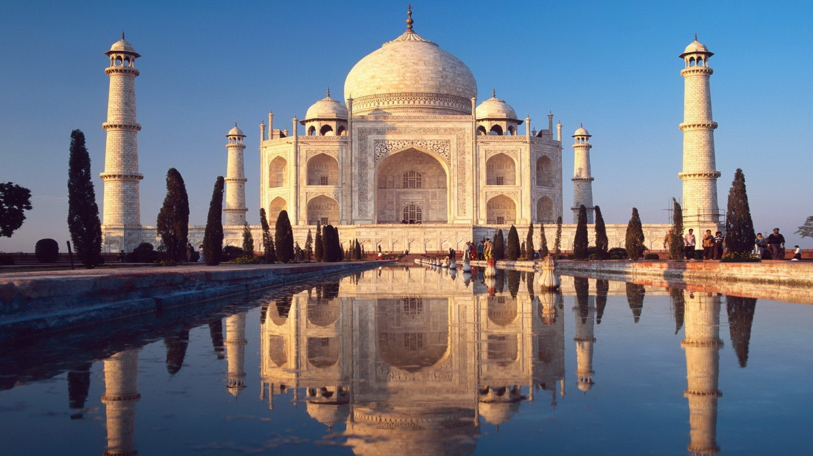

Slide 3
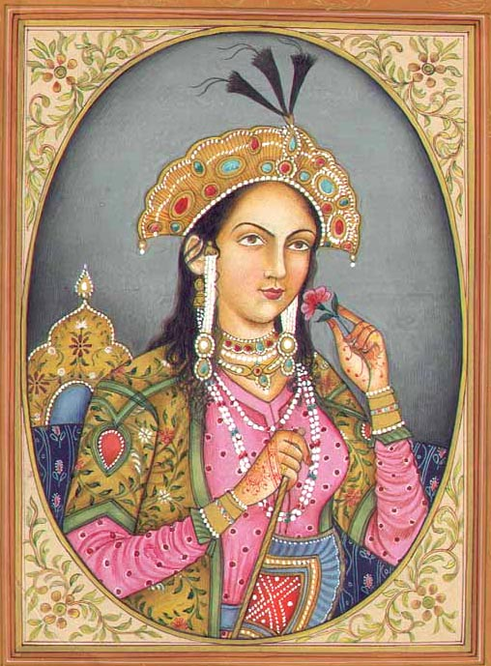
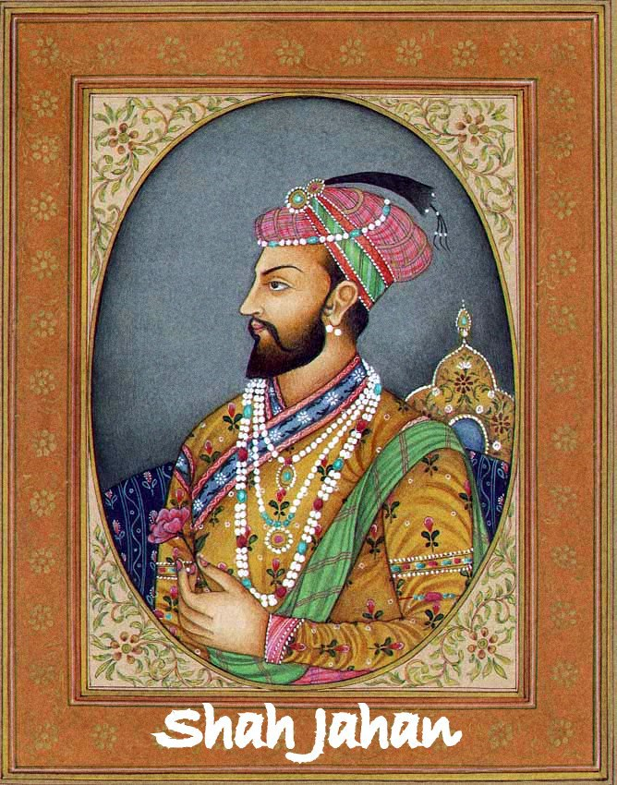
Mumtaz Mahal

Slide 4
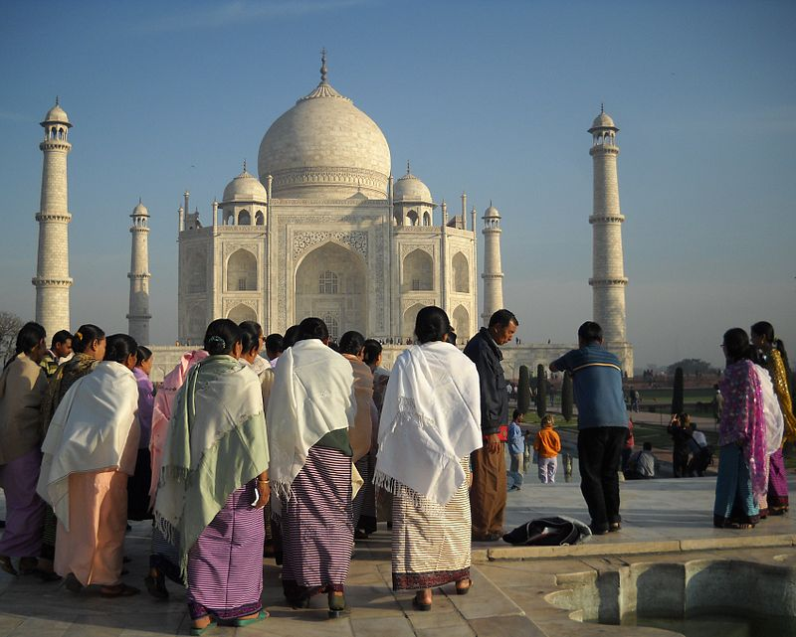
The Taj Mahal was designated as a UNESCO World Heritage Site in 1983 for being "the jewel of Muslim art in India and one of the universally admired masterpieces of the world's heritage".

Slide 5
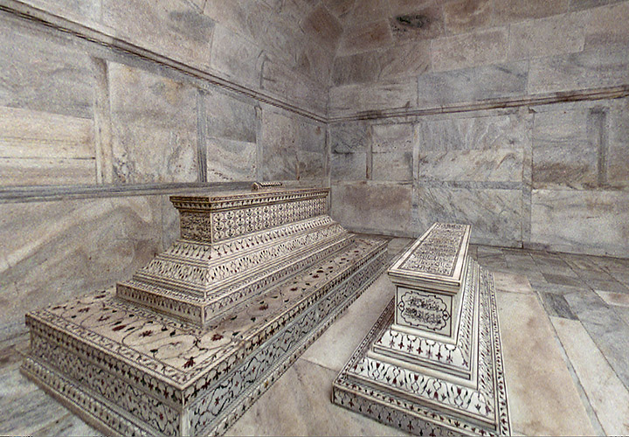

Slide 6
Some facts about Taj Mahal
Taj Mahal translates like Palace of the Greatest.
It took 21 years (1632-1653) to build the Taj Mahal. It was build by 22 thousand people who came from Persia, Middle East and Central Asia.
Mumtaz Mahal was the third wife of Shah Jahan.
In 1857, during the Indian uprising , the British soldiers nearly destroyed the Taj - Mahal , picking out with its walls of precious stones.

Slide 7
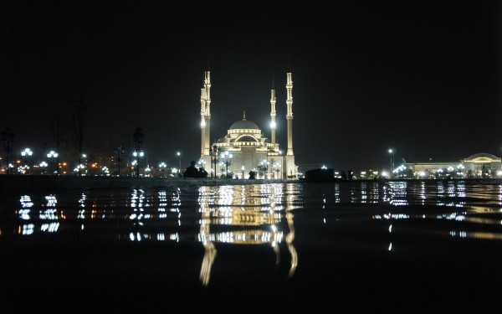
b

Slide 8
Some more facts about Taj Mahal
It is forbidden to fly airplanes over the Taj Mahal.
There is a popular myth, which states that Shah Jahan wanted to build in front of the Taj Mahal another black marble mausoleum, but he did not do it because he was deposed and imprisoned in their own chambers by his own son Aurangzeb.
There are calligraphic inscriptions of 99 names of God on the sides of the tMumtaz Mahal’s tomb.
Since November 28th, 2004 the Taj Mahal mausoleum’s been opened five nights a month for all night visitors ( At the day of the full Moon, two days before and after it).

Slide 9
THANKS FOR your ATTENTION =^.^=

