Slide 1
Indian spices

Slide 2
Indian spices include a variety of spices grown across the Indian subcontinent (a sub-region of South Asia). With different climates in different parts of the country, India produces a variety of spices, many of which are native to the Subcontinent, while others were imported from similar climates and have since been cultivated locally for centuries.

Slide 3
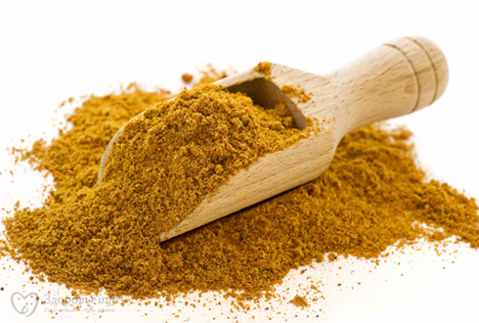
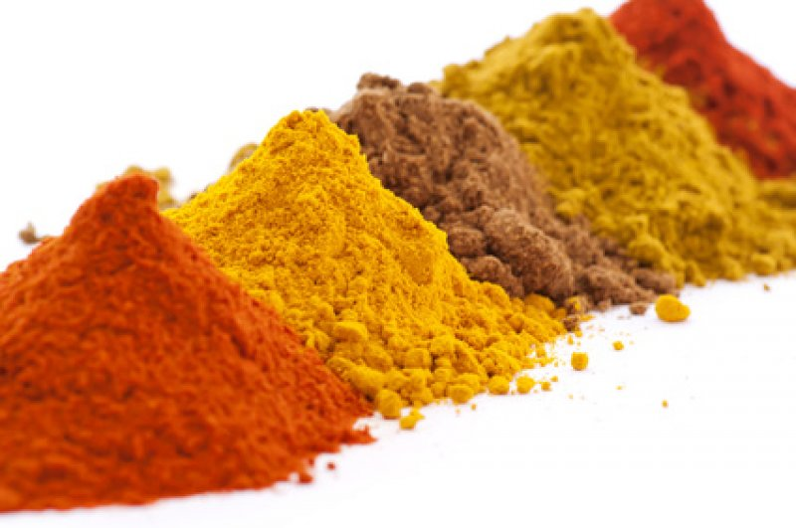
Curry is not a spice, but a term used by Western people and refers to any dish in Indian cuisine that contains several spices blended together, whether dry or with a gravy base.

Slide 4
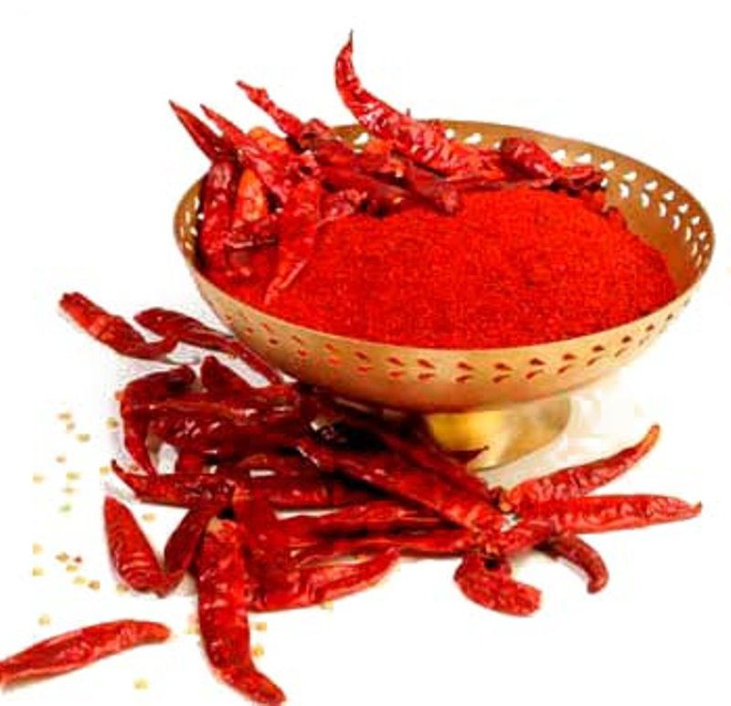
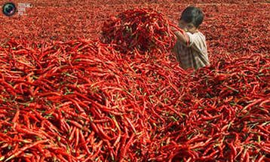
The chili pepper is the fruit of plants from the genus Capsicum, members of the nightshade family, Solanaceae. In Australia, Britain, India, Ireland, New Zealand, Pakistan, South Africa and in other Asian countries, it is usually known simply as chilli. India is the world's biggest producer, consumer and exporter of chili peppers. Guntur in the South Indian state of Andhra Pradesh produces 30% of all the chilies produced in India. Andhra Pradesh as a whole contributes 75% of India's chili exports.

Slide 5
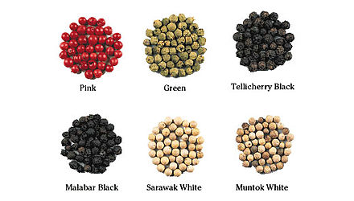
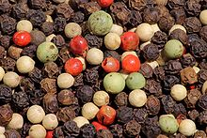
Varieties of peppercorns

Slide 6
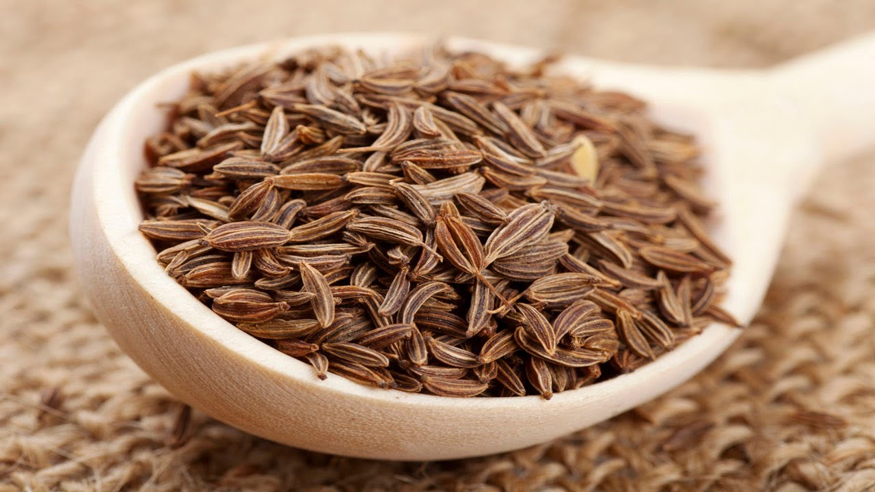
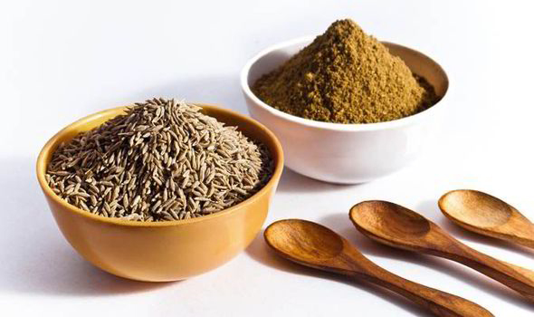
Cumin, known as ‘Jeera’ in India, can be purchased as whole seeds or in powder form and comes from a dried, white fruit on an annual herb that is a tropical plant grown in many parts of the world. The seeds are bitter and have an aromatic odor.

Slide 7
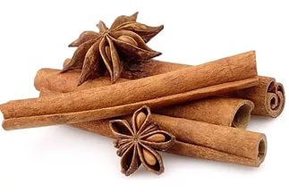
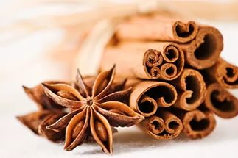
Cinnamonis derived from the bark of a hardy, evergreen tree and is native to India. What is known as the ‘true cinnamon’ or Sri Lankan Cinnamon is the dried inner stem bark of the Cinnamomum Verum. They are grown as bushes and are ready for harvesting after two years of growth. The fragrance is sweet, earthy and a warm enjoyable taste. It is also used as a powder in cooking as well as in dried sticks.

Slide 8
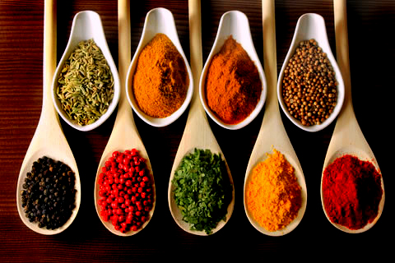
Spices are used in different forms: whole, chopped, ground, roasted, sautéed, fried, and as topping. They blend food to extract the nutrients and bind them in a palatable form. Some spices are added at the end as a flavouring and are typically heated in a pan with ghee or cooking oil before being added to a dish. Lighter spices are added last, and spices with strong flavour should be added first.

Slide 9
Thank you for your attention
Made by Arina Baranseva
And Rita Gudkovich

