Slide 1
Culture of the Ottoman Empire
Nikanorov Max and Shinkevich Ivan

Slide 2
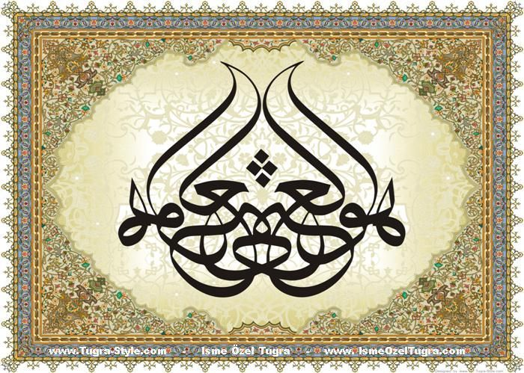
Calligraphy is the art of the contour lines which are closely associated with the art of miniature.

Slide 3
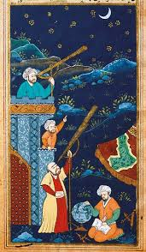
miniatures
It is believed that the school of the Ottoman artists was born only after Selim I (1512— 1520) who had brought artists from Damascus and especially from Tabriz and Herat after 1514. It just explains the importance of the Persian contribution to the art of miniatures, pottery and bookbinding.

Slide 4
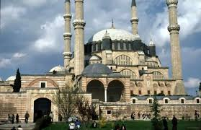
architecture

Slide 5
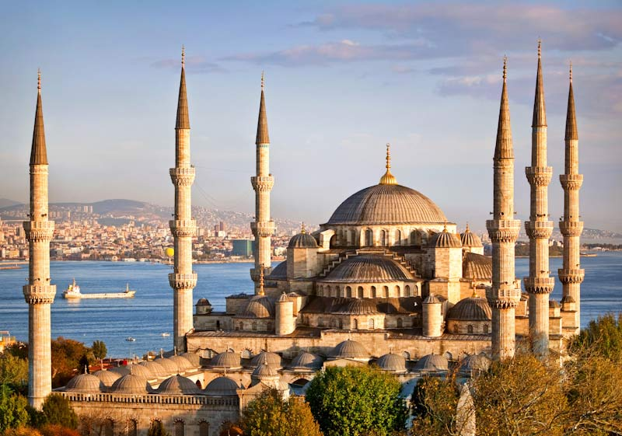
Ottoman architecture
Ottoman architecture emerged in Bursa and Edirne in the fifteenth and sixteenth centuries. The architecture of the Ottoman Empire can be traced to the influence of the architecture of Seljuk and Armenian, Iranian, Byzantine architecture. After the conquest of Constantinople by the Turks the influence of Mamluk architectural traditions could be noticed. For almost 400 years Byzantine churches and cathedrals served as models for Ottoman mosques.
The Mosque

Slide 6
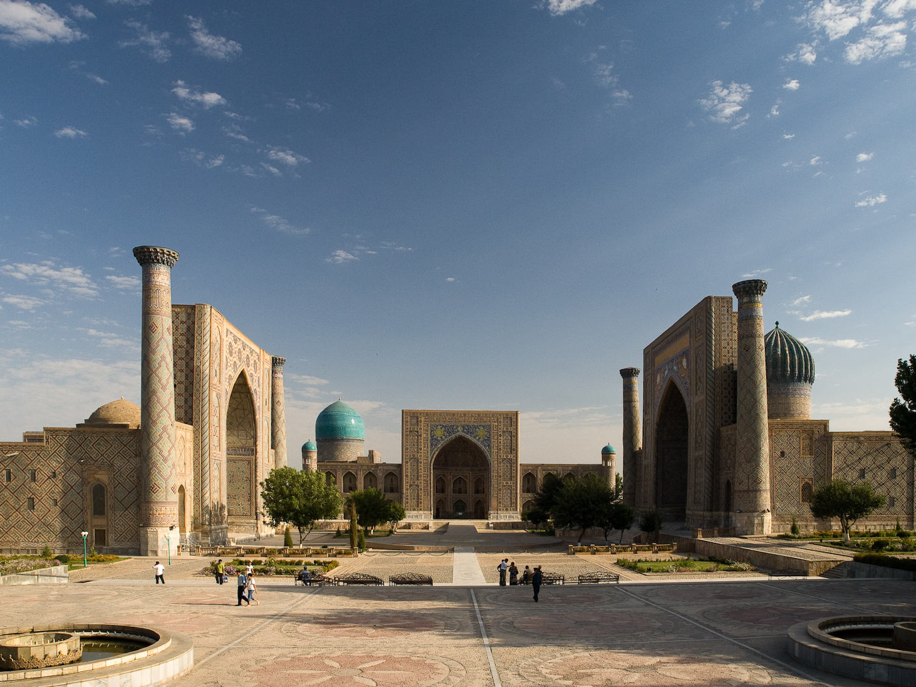
Registan is the ensemble of three madrasas, in Samarkand, modern day Uzbekistan.
The Ottomans reached a high level architecture. Mastered their technique of creating a huge internal space with vaults, domes, semi-domes and columns are allowed to create aesthetic and elegant sophisticated style in Islamic architecture. To this day you can find items in the style of Ottoman architecture in the former territories of the Empire.

